Slide 1
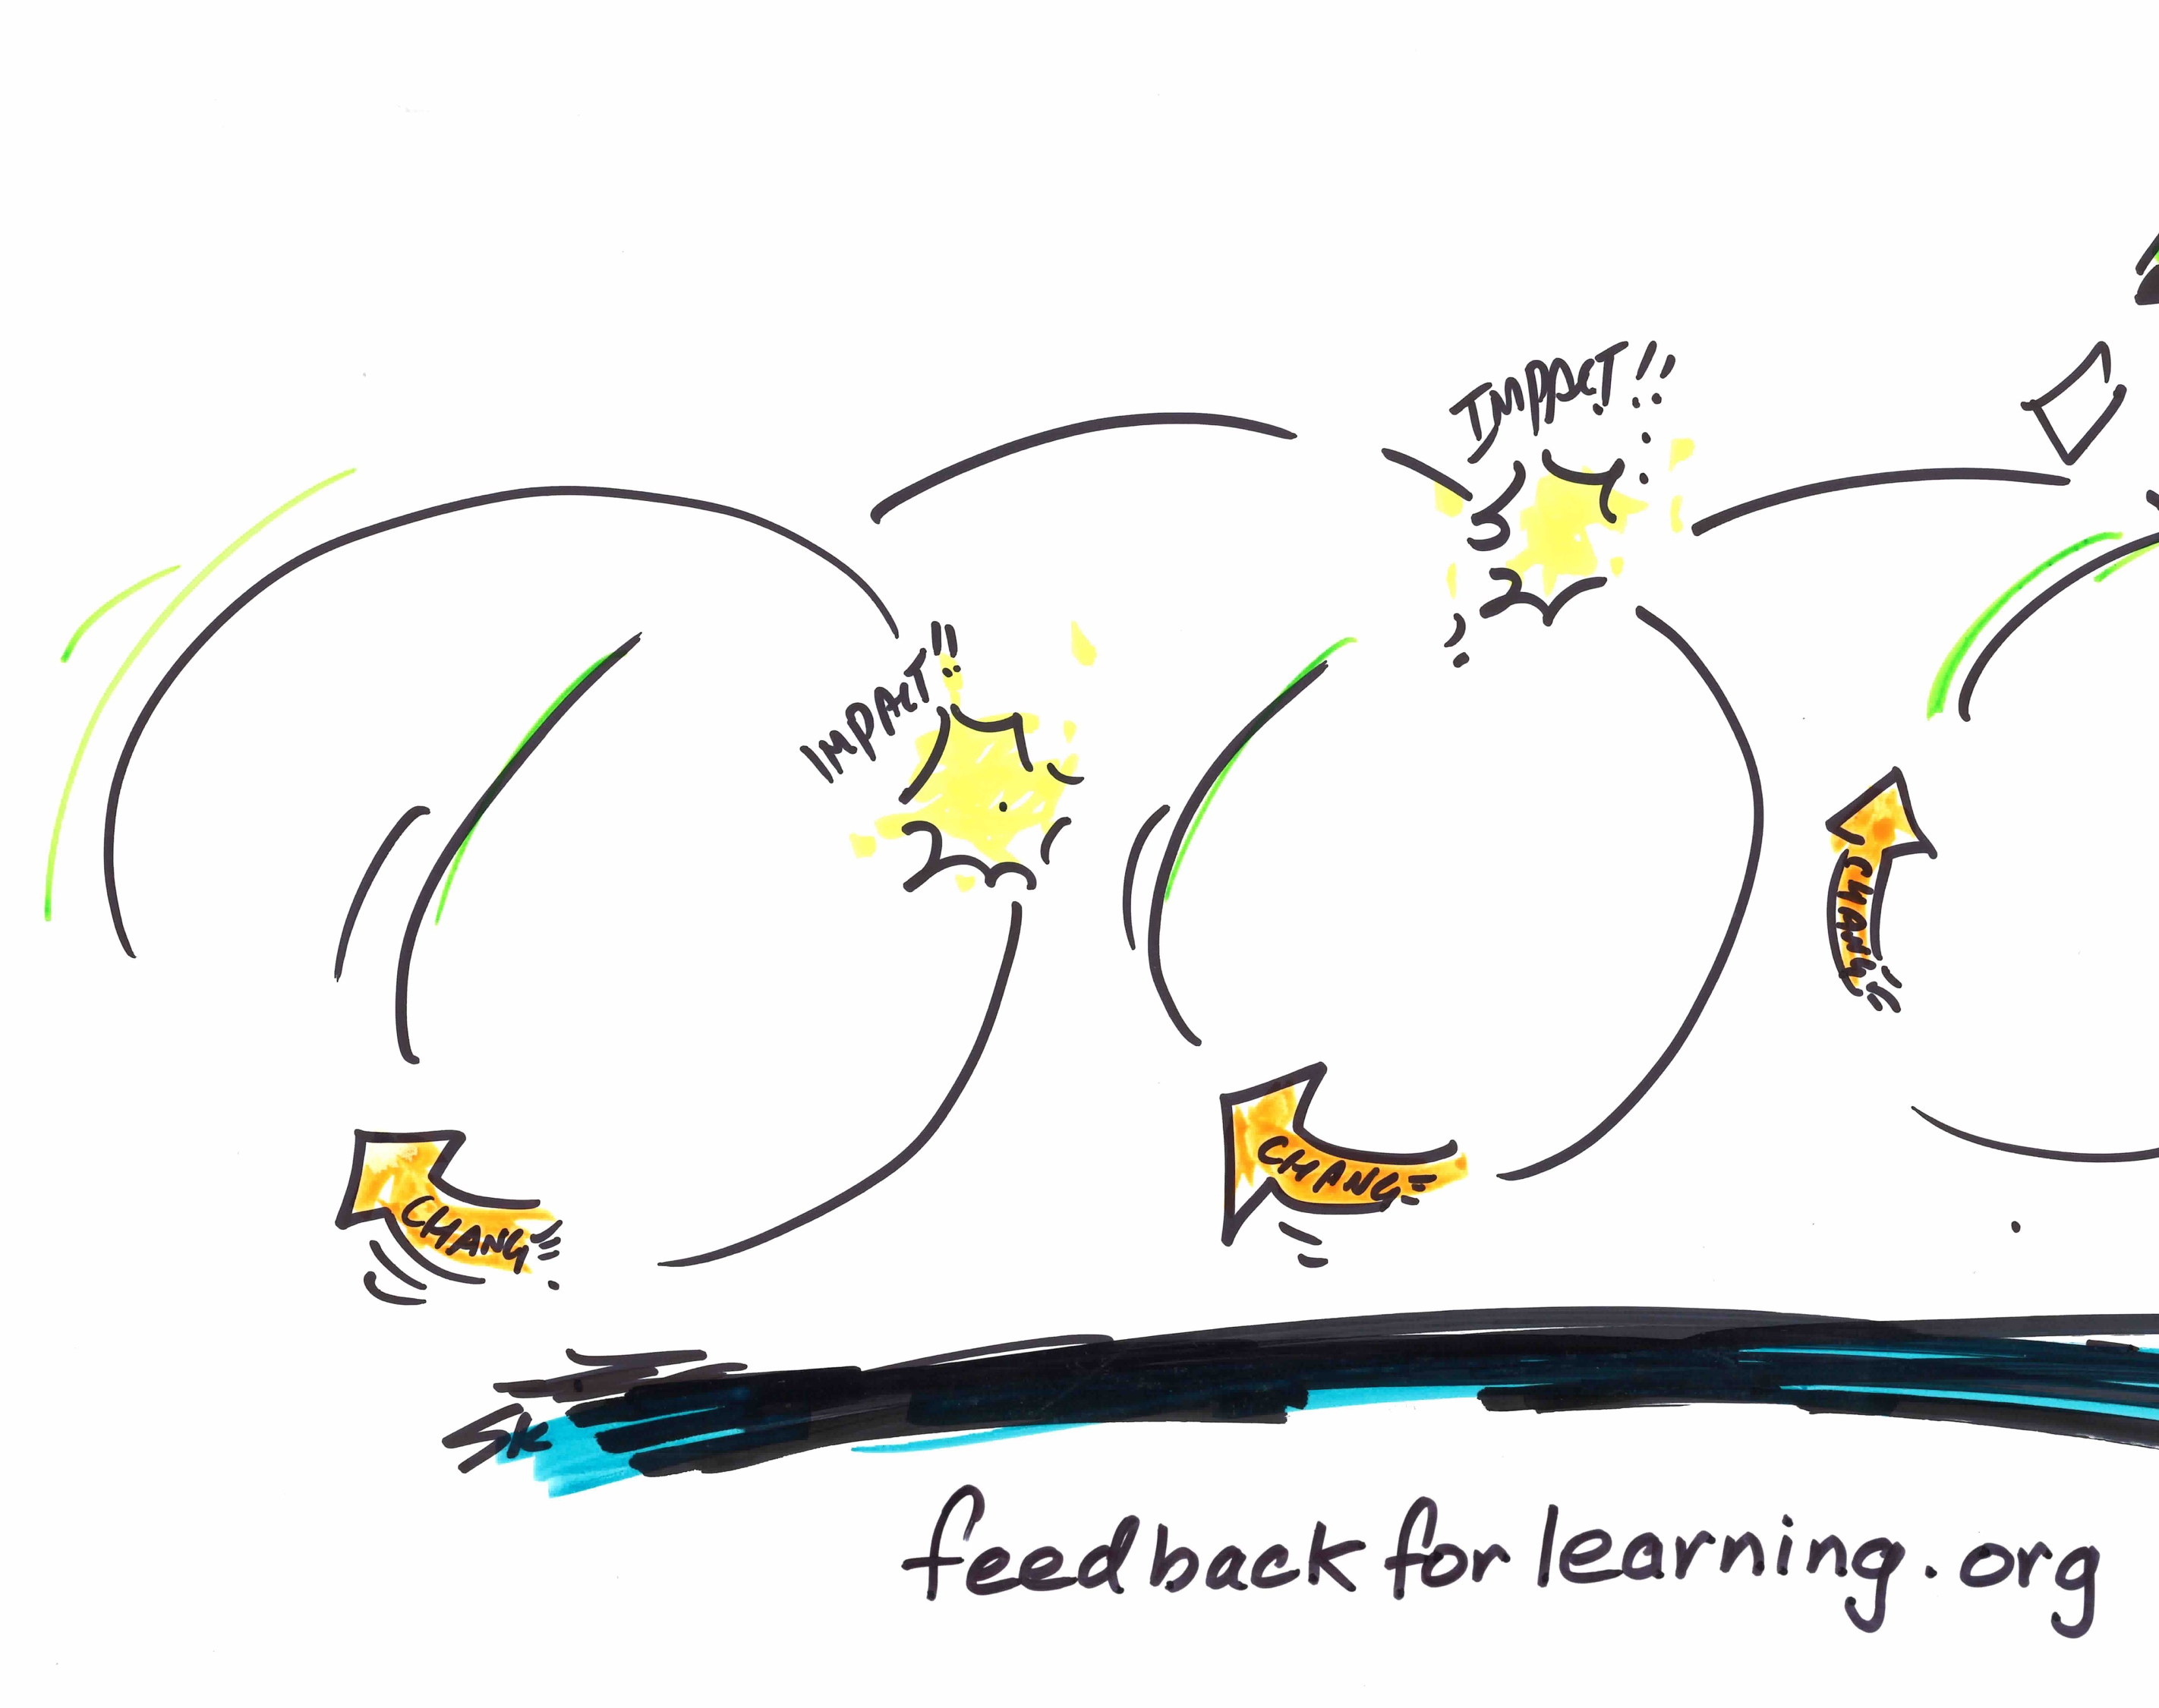
Feedback and feedback literacy
Professor Phillip (Phill) Dawson
Centre for Research in Assessment and Digital Learning (CRADLE)
Deakin University
@phillipdawson

Slide 2
Three things to take from this presentation
There has been a shift in what we think of as effective feedback
What feedback literate students do
What feedback literate educators do
@phillipdawson

Slide 3
What are the problems with feedback?

Slide 4
Feedback should be more work for the recipient than it is for the donor (William, 2011)
But how???
William, D. (2011). Embedded formative assessment: Solution Tree Press.

Slide 5
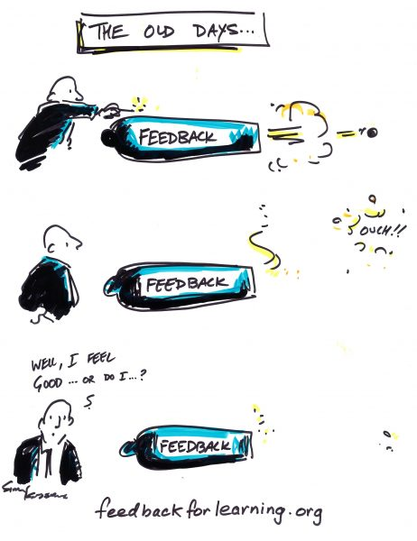
There has been a shift in what we think of as effective feedback

Slide 6
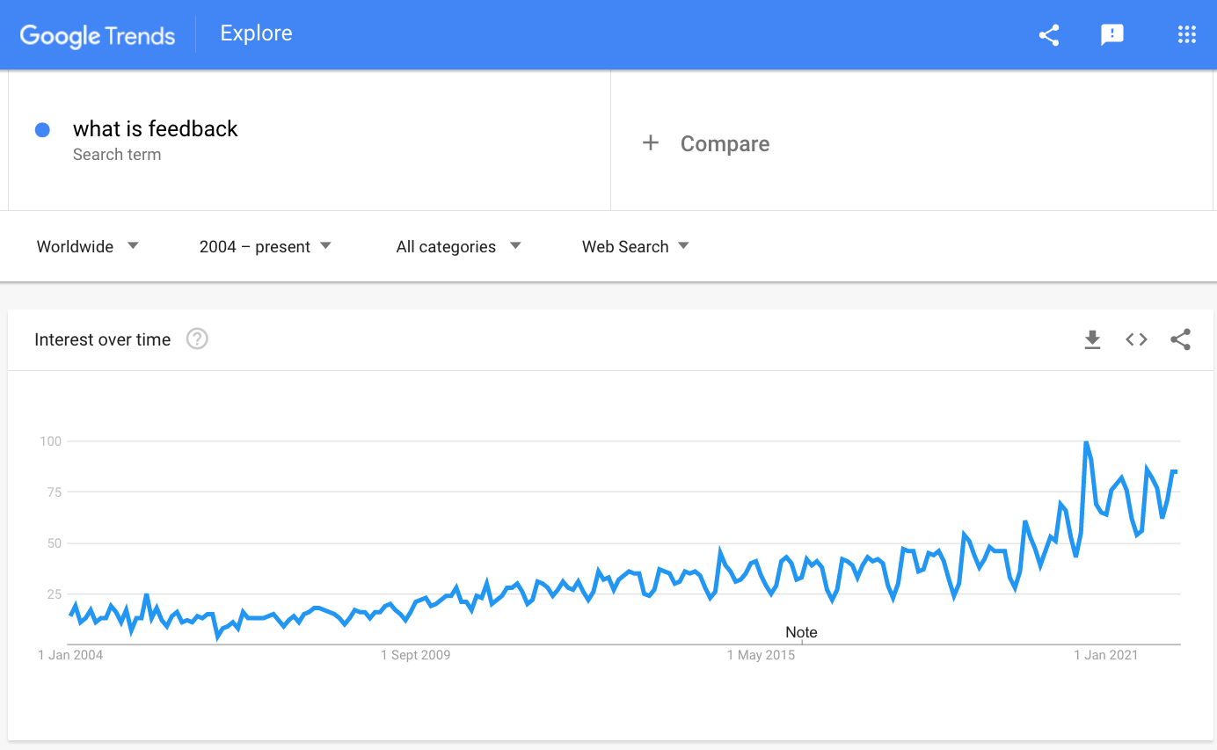
Feedback is: “a process in which learners make sense of information about their performance and use it to enhance the quality of their work or learning strategies.”
Henderson, M., Phillips, M., Ryan, T., Boud, D., Dawson, P., Molloy, E., & Mahoney, P. (2019). Conditions that enable effective feedback. Higher Education Research & Development, 38(7), 1401-1416.

Slide 7
This is not feedback
“I left feedback on their final essays, which they never collected”

Slide 8
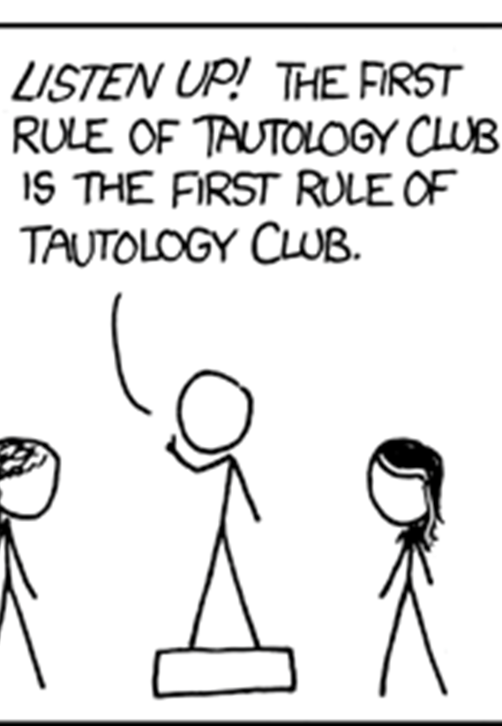
Effective feedback requires effects
https://xkcd.com/703/

Slide 9
Three things to take from this presentation
There has been a shift in what we think of as effective feedback
What feedback literate students do
What feedback literate educators do
@phillipdawson

Slide 10
What should students do when they receive feedback information?

Slide 11
What do you do when you receive feedback information?

Slide 12
How did you learn to act in this way?

Slide 13
Feedback literacy: “﻿the understandings, capacities and dispositions needed to make sense of information and use it to enhance work or learning strategies.”
Carless, D., & Boud, D. (2018). The development of student feedback literacy: enabling uptake of feedback. Assessment & Evaluation in Higher Education, 43(8), 1315-1325. https://doi.org/10.1080/02602938.2018.1463354

Slide 14
Carless, D., & Boud, D. (2018, 2018/11/17). The development of student feedback literacy: enabling uptake of feedback. Assessment & Evaluation in Higher Education, 43(8), 1315-1325. https://doi.org/10.1080/02602938.2018.1463354

Slide 15
Three things to take from this presentation
There has been a shift in what we think of as effective feedback
What feedback literate students do
What feedback literate educators do
@phillipdawson

Slide 16
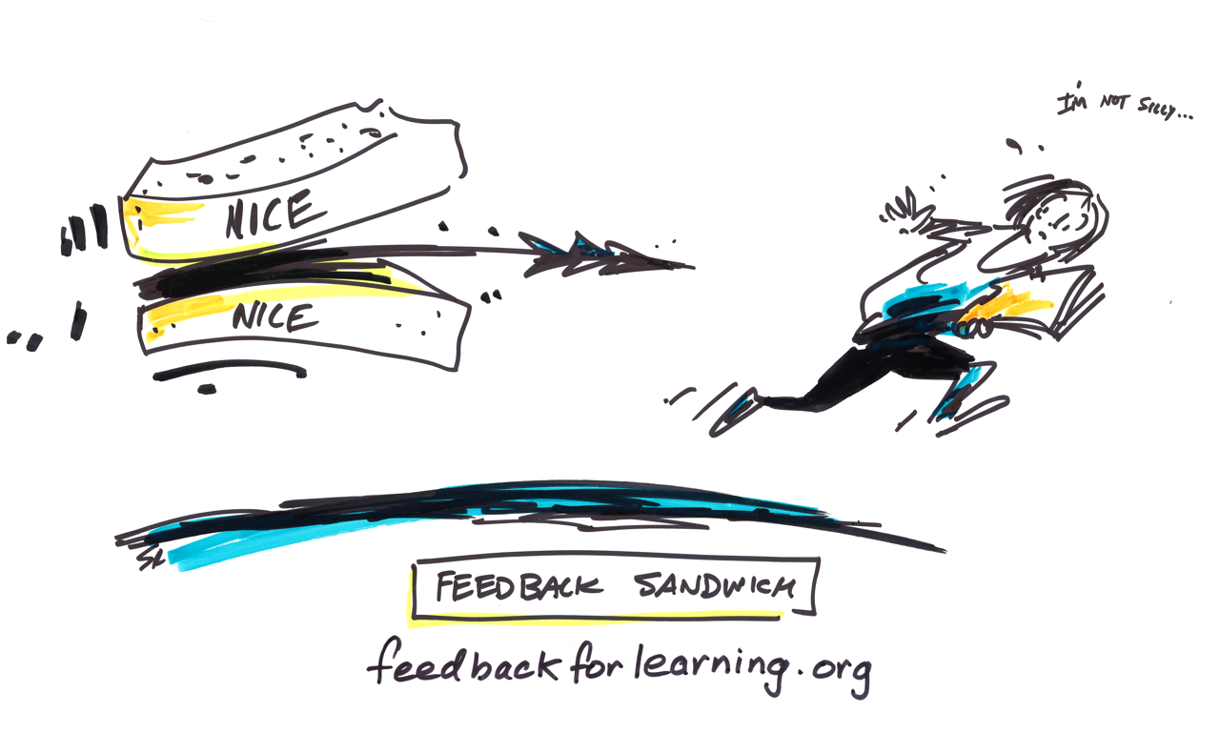
Improving feedback comments won’t necessarily improve student feedback literacy

Slide 17
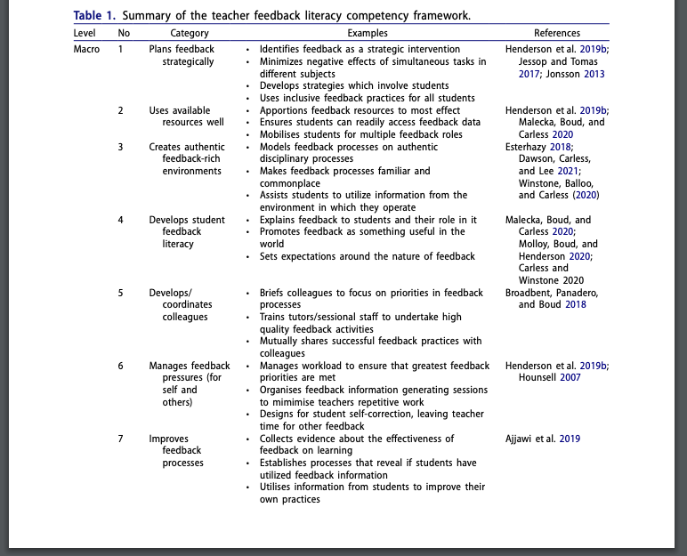
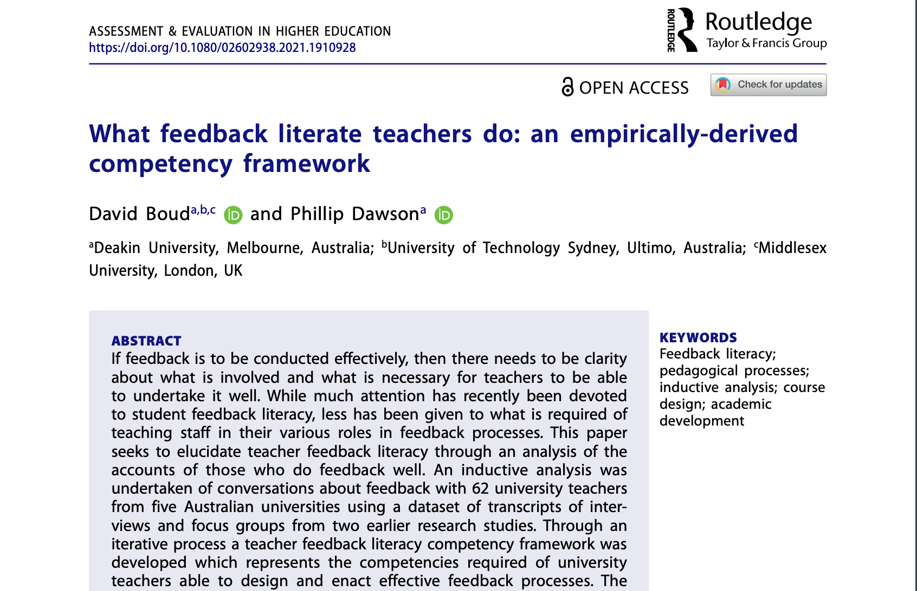
What feedback literate teachers do

Slide 18
Nineteen competencies across three levels
macro: programme design and development
meso: course module/unit design and implementation
micro: feedback practices relating to individual student assignments

Slide 19
Focus on these meso design competencies today

Slide 20
What to think about when designing feedback
Focus less on what the teacher says
Focus on ‘what the student does’
View feedback as a teaching and learning activity
Build assessment sequences that incorporate feedback loops

Slide 21
(if we have time) a feedback design example
Course information
Feedback design
Introductory education course on effective teaching in higher education
Flipped classroom mode; students could choose f2f or online for synchronous component
Three assessment tasks: literature synthesis; feedback from students and peers about teaching; portfolio
Feedback seeking incorporated into task
Formative peer feedback
Comparing teacher assessment and student self-assessment

Slide 22
Feedback design: feedback seeking incorporated into task
Students are required to seek feedback from their peers and their students
Scaffolds are provided: peer observation forms, feedback survey questions
Main focus of task is analysing feedback comments and making a plan for how to address them

Slide 23
Feedback design: comparing teacher assessment and student self assessment
Students are required to self-assess on rubric and submit as mandatory part of task
Students are also required to make specific feedback requests
Teacher assesses on separate copy of rubric
Teacher feedback comments address both the specific feedback requests and how judgements on the rubric differ

Slide 24
Feedback design: formative peer feedback
Two weeks of classes are devoted to peer feedback on draft work
Class is student-led; students are provided with an agenda but they facilitate the class
Focus is on peer feedback not peer assessment
Rubric used as a scaffold

Slide 25
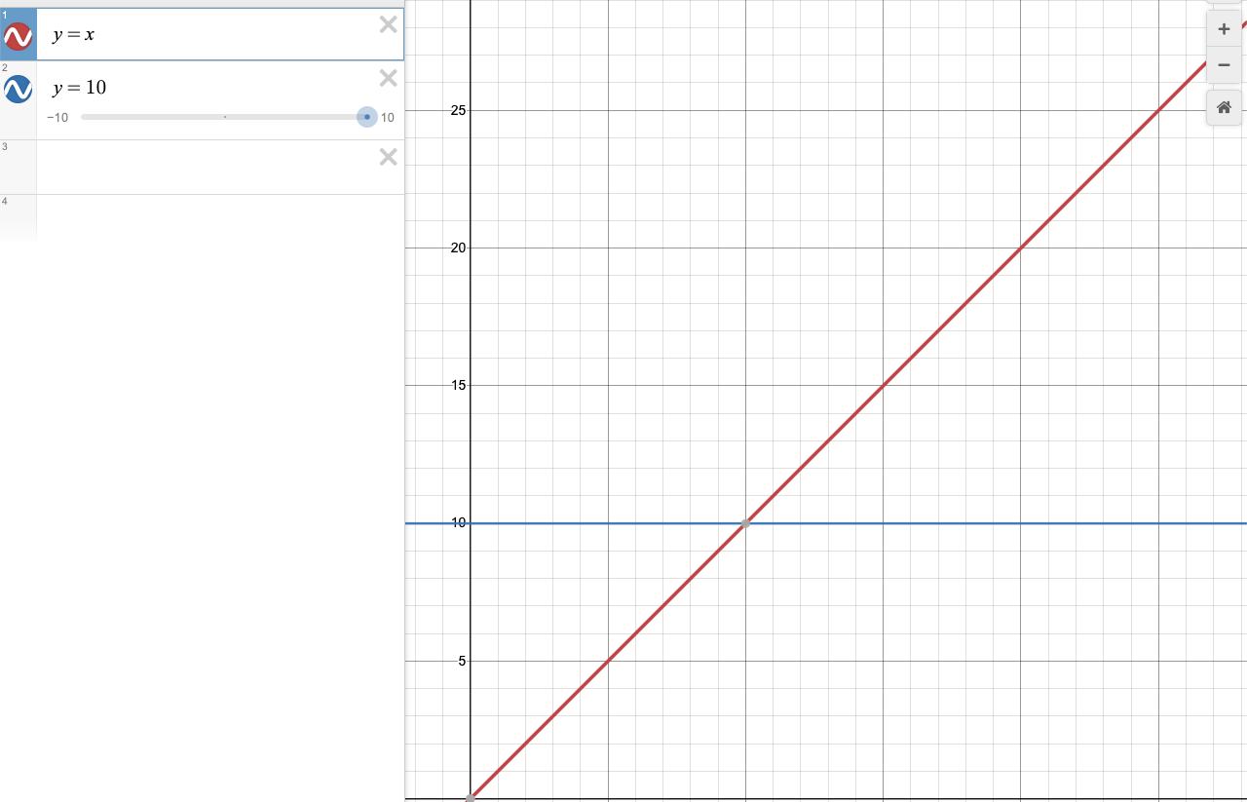
Improving feedback design is more scalable than improving feedback comments
Spending more time on feedback comments scales at O(n)
Spending more time on feedback design scales at O(1) – assuming you are focusing on what students do

Slide 26
Suggestions
Focus more on effective feedback and less on good feedback
Spend more effort on feedback design and less on feedback comments
Focus on what students do in feedback – require them to make requests and generate feedback
Share what we do in our feedback practices
Keep an ear out for news of our ARC Discovery Project on feedback literacy

Slide 27
Three things to take from this presentation
There has been a shift in what we think of as effective feedback
What feedback literate students do
What feedback literate educators do
@phillipdawson

